Slide 1

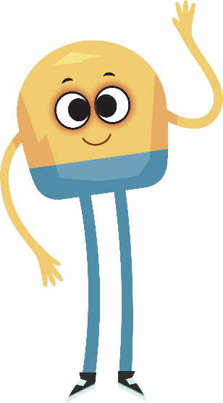

Unit 3: Week 5
Grade K

Slide 2
Copyright © Savvas Learning Company LLC. All Rights Reserved.
This publication is protected by copyright, and permission should be obtained from the publisher prior to any prohibited reproduction, storage in a retrieval system, or transmission in any form or by any means, electronic, mechanical, photocopying, recording, or otherwise. For information regarding permissions, request forms, and the appropriate contacts within the Savvas Learning Company Rights Management group, please send your query to:
Savvas Learning Company LLC, 15 East Midland Avenue, Paramus, NJ 07652
or
k12learningpermissions@savvas.com
myView Literacy® is an exclusive trademark of Savvas Learning Company LLC in the U.S. and/or other countries.

Slide 3

Lesson 1

Slide 4
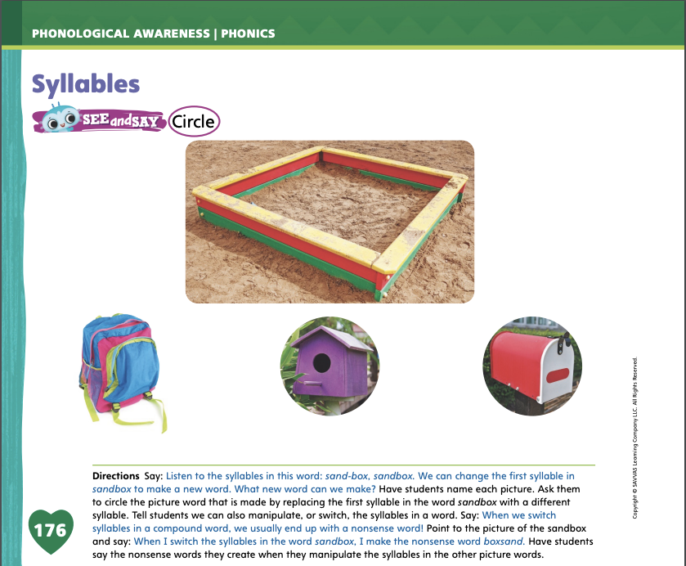
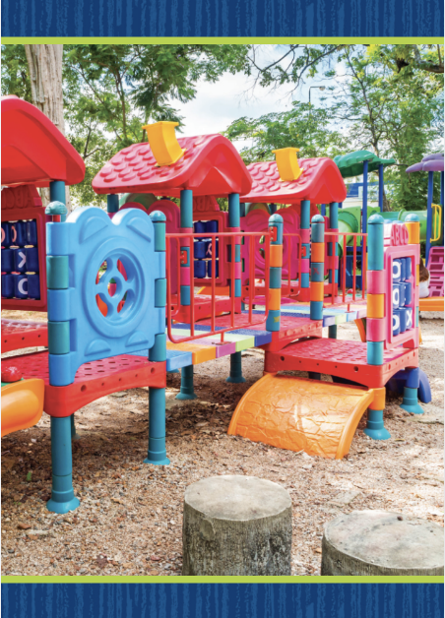
Page 176
Phonological Awareness
Turn to page 176 in your Student Interactive.
Notes:
Tell students that today they will do more work with syllables. Who can tell me what syllables are? Yes, syllables are word parts. We can manipulate, or switch, syllables to make new words. Display the playground Picture Card. Click path -> Table of Contents -> Unit 3 Week 5 Myth -> Lesson 1 Listen to the syllables in this word: play (pause) ground. Now I will switch the syllables: groundplay. That is a nonsense word! I can also change a syllable in the word playground to a different syllable to make a new word. I will change the first syllable to camp. Listen: camp (pause) ground. What is the new word? (campground)
Have students turn to p. 176 in the Student Interactive. Name the pictures with students. Then say: Listen to the syllables in this word: sand (pause) box. If we change the first syllable, which word can we make? Have students circle the picture word. Then have students practice manipulating the syllables in the picture words to make nonsense words.

Slide 5
Phonics
bit
dim
dime
pin
pine
bite
Notes:
Display bit and have students read the word with you. What sound do you hear in the middle of bit? (/i/) Circle the letter i. The letter i stands for the sound /i/ in bit. Display bite and read it aloud. Have students repeat. Point out that bit and bite have the same beginning and ending sounds but different middle sounds. Bite has the sound /ī/. Adding the letter e to the word bit changes the middle sound from /i/ to /ī/. Circle the letters i and e in the word bite. The pattern i_e spells the sound /ī/.
Display the words dim, dime, pin, and pine. Have students read each word, identify the vowel sound, and name the letter or letters that spell the sound.

Slide 6
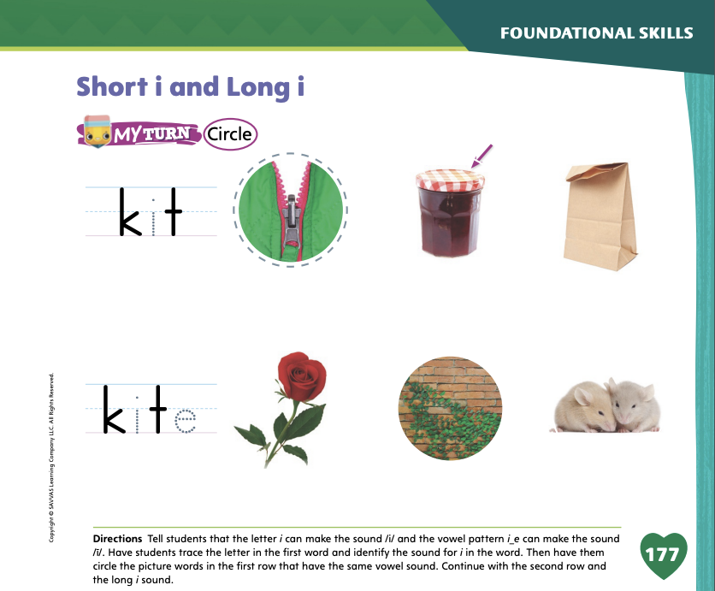
Page 177
Phonics
Turn to page 177 in your Student Interactive and complete the activity.
Notes:
Have students look at p. 177 in the Student Interactive. Ask them to trace the letters and read the words. Then have them point to the first picture. Listen carefully to this word: /z/ /i/ /p/, zip. Does zip have the same middle sound as kit? Students should say yes and circle the picture of the zipper. Have students complete the page.

Slide 7
High-Frequency Words
funny
were
some
Notes:
Display the high-frequency words funny, were, and some.
Point to the word funny and read it.
Have students point to the word funny and read it.
Repeat for were and some.

Slide 8
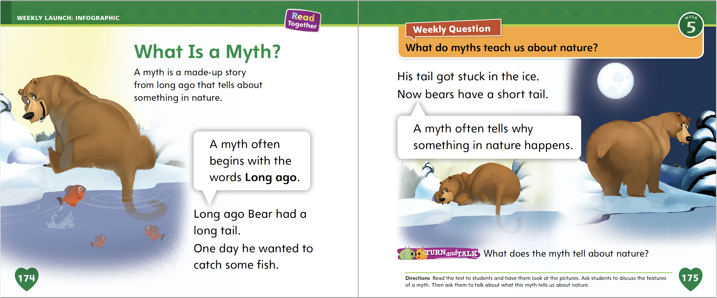
Page 174,175
Interact with Sources
Essential Question: Why do we like stories?
Weekly Question: What do myths teach us about nature?
Notes:
Remind students of the Essential Question for Unit 3: Why do we like stories? Point out the Week 5 Question: What do myths teach us about nature? Explain that students will learn what myths teach us about nature this week. Tell them that myths are old stories that explain parts of nature. Myths are often shared orally, or told aloud to others. Many people in a culture know the same myths.
Read aloud the infographic on pp. 174–175. Then have student volunteers retell the story. Ask these questions:
Who is the main character in this myth? Point out that the character is a bear, which is part of nature.
When does the myth take place? Point out that it takes place long ago. Myths usually tell about events from a long time ago. They explain why things in nature are as they are.
Have students interact with the infographic by completing the Turn and Talk activity on p. 175 in the Student Interactive.
Reread the Week 5 Question: What do myths teach us about nature? Tell students that they have just heard a myth about Bear and his tail. Remind them that this myth is about something in nature: an animal. The myth tells why the animal is the way it is. Tell students that they will learn more about myths this week.

Slide 9
Listening Comprehension
How Rabbit Got Its Ears
BEGINNING: Rabbit wanted to know what the other animals were doing
MIDDLE:
END:
Notes:
Tell students that you are going to read aloud a myth. Explain: A myth is a fictional story with a plot. The most important part of a myth’s plot is the main event—the main thing that happens to the character, which causes excitement. Listen for the main event in “How Rabbit Got Its Ears.”
Purpose Have students listen actively for parts of the plot, especially the main event.
READ the entire text aloud without stopping for the Think Aloud callouts.
REREAD the text aloud, pausing to model the Think Aloud strategies related to the genre.
Work with students to list what happens in the Read Aloud story. Ask students what happens at the beginning. Then ask them what happens in the middle. Finally, ask what happens at the end of the story.
Have a volunteer retell the myth.

Slide 10
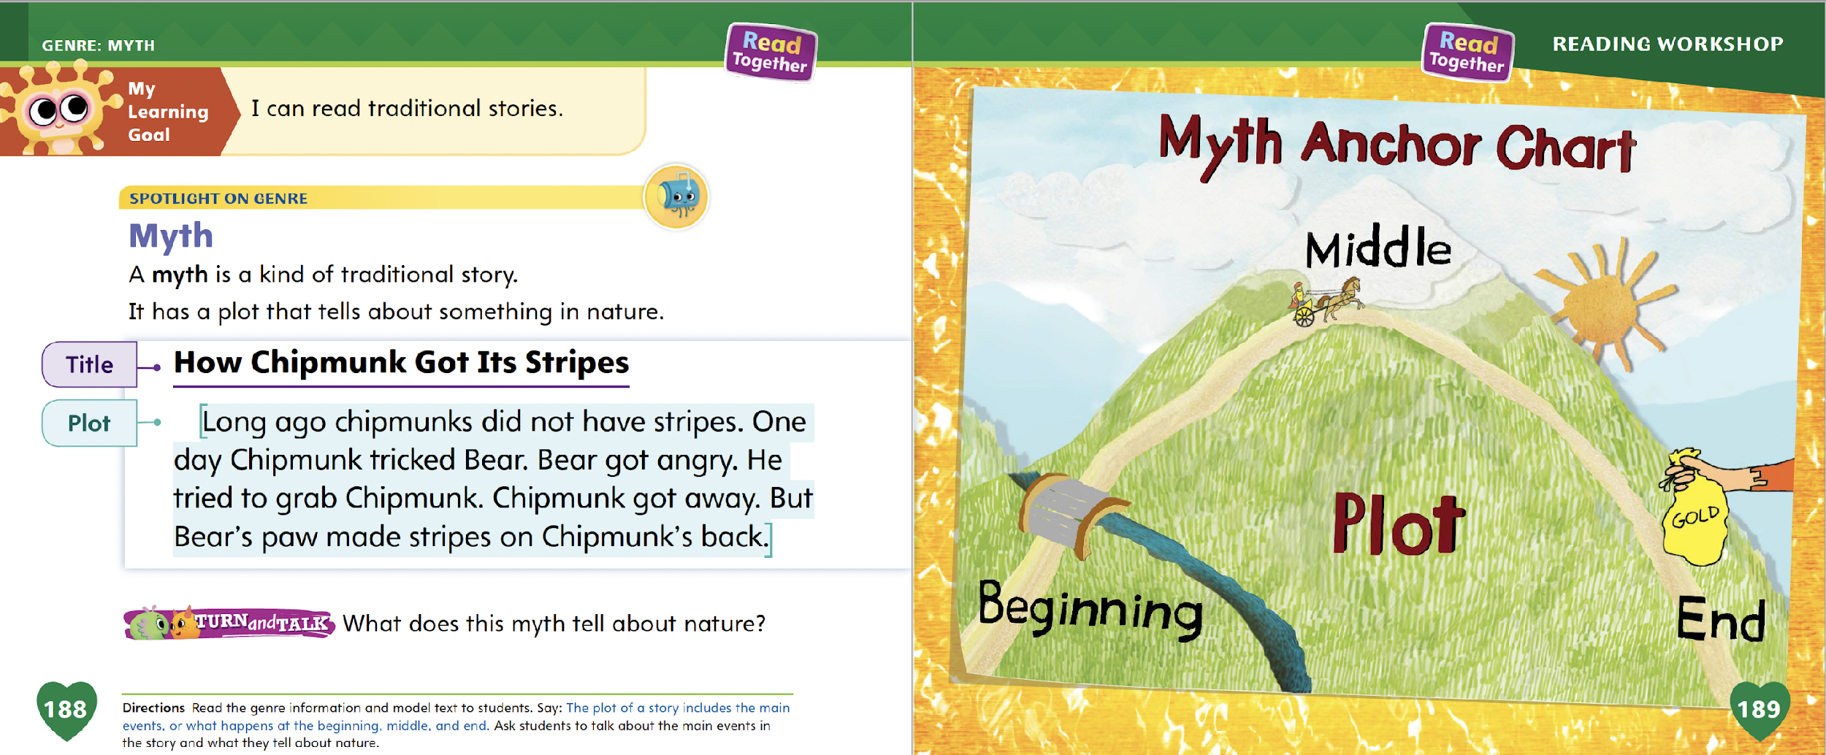
Page 188,189
Myths
Turn to page 188 in your Student Interactive.
Notes:
Explain to students that a myth is a kind of traditional story generally passed down orally. Myths tell us about nature, such as how a deer got its horns or how thunder got its voice. Myths are generally:
told by a narrator, or someone who is not part of the story;
set a long time ago;
used to help explain things in nature.
Remind students that they listened to a selection called “How Rabbit Got Its Ears.” Tell them that “How Rabbit Got Its Ears” is a myth, and that it has a plot including a main event. Explain why it is a myth.
This story happened long ago. It tells why rabbits have long ears, a change in nature. The story is told by a narrator who knows all about what happened.
Turn to p. 188 of the Student Interactive and read aloud “How Chipmunk Got Its Stripes.” Talk to students about how this story is similar to the Read-Aloud story. Editable Anchor Chart Click Path: Table of Contents -> Reading Anchor Charts -> Unit 3 Week 5: Myth Editable Reading Anchor Chart

Slide 11
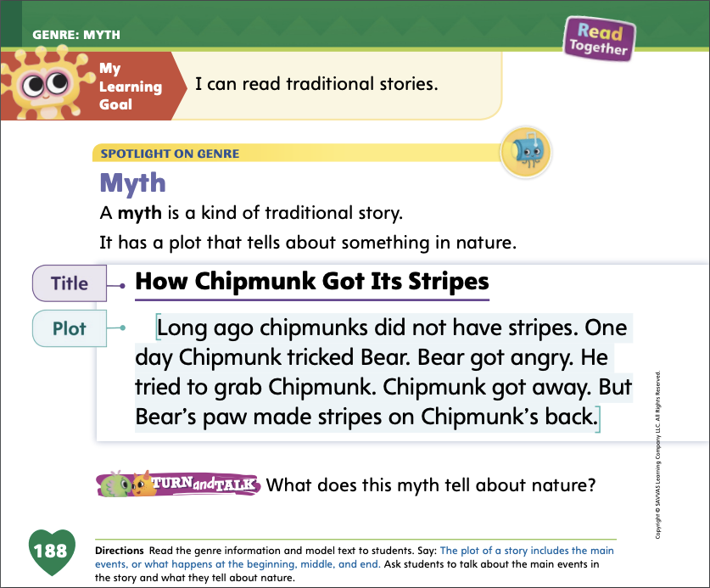

Page 188
Apply
What does this myth tell about nature?
Notes:
Have students use the strategies to identify myths.
Have students find a partner and complete the Turn and Talk activity on p. 188 of the Student Interactive. Then lead a class discussion of the main event in the myth on this page.

Slide 12
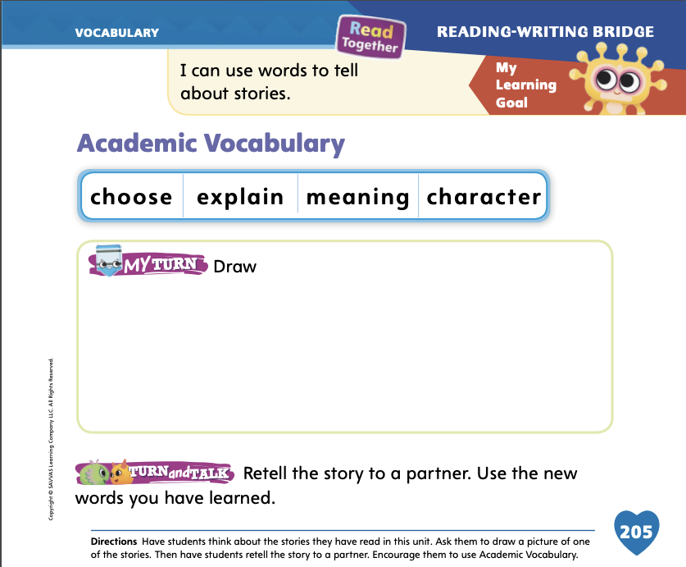
Page 205
Academic Vocabulary
Turn to page 205 in your Student Interactive and complete the activity.
Notes:
Explain to students that the week’s Academic Vocabulary words can help them talk about stories they have read. Say:
A character is who a story is about.
To explain something is to say how or why it happens. Some events in stories explain other events.
The meaning of a story is what the author wants us to know or think after reading it.
To choose means to select. I might choose what book to read.
Show students how to use Academic Vocabulary words to talk about stories they have read. I can use the word character to describe a story from this unit. Remember the myth that we read about how Bear got a short tail? The main character in the story was Bear. Have students take turns choosing an Academic Vocabulary word to use to tell something about a story they have read during this unit.

Slide 13
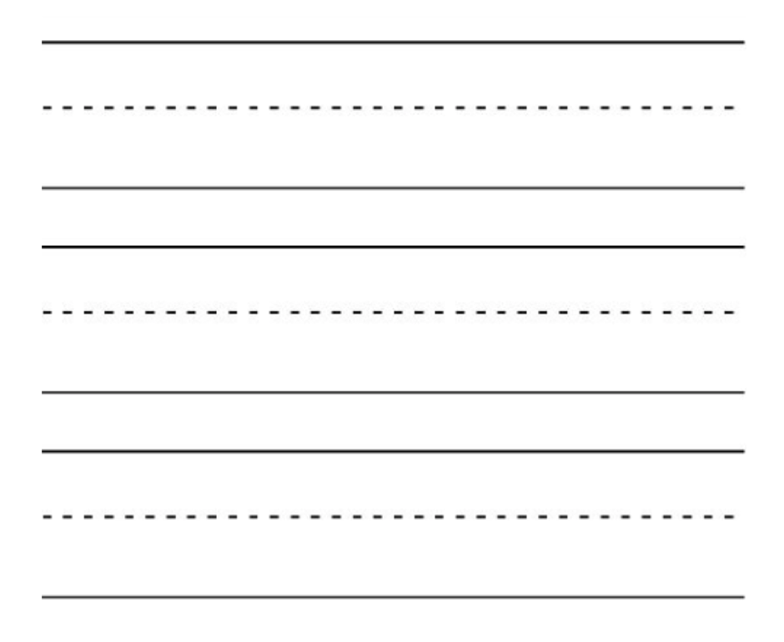
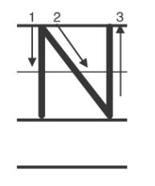
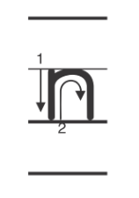
Handwriting
Notes:
Display upper- and lowercase Nn.
Model how to write the uppercase letter N. Show students where to begin and how to form it. Have students practice writing the letter in the air with their fingers. Then repeat with the lowercase letter n.
Have students complete Handwriting p. 146 from the Resource Download Center to practice writing Nn. Click path: Realize -> Table of Contents -> Resource Download Center -> Handwriting Practice -> U3W5L1 Handwriting Practice

Slide 14
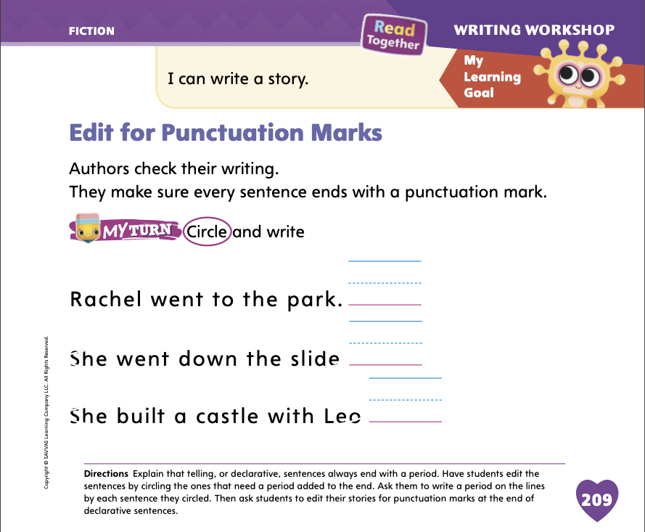
Page 209
Writing – Fiction
Turn to page 209 in your Student Interactive and complete the activity.
Notes:
Before publishing their work, authors check and revise their writing. They make sure to use punctuation at the end of sentences. Periods show readers where the end of a telling, or declarative, sentence is so they know when to pause before starting a new sentence.
Gather students and read them a short book from the stack. As you read aloud, do not stop for punctuation. Continue reading in run-on sentences until students notice a problem. When you stop reading, explain that you read the story without paying attention to punctuation. Say: Punctuation at the end of a sentence is important because it separates ideas. It makes readers stop and take a breath after each sentence. Without punctuation, words in a sentence do not make sense. Reread the same story, this time stopping deliberately at periods in a sentence.
Page through other stack books and point out punctuation at the ends of sentences. Students may also point out question marks and exclamation points. Explain that these punctuation marks show a question and feeling. Write a simple sentence from a stack text on the board, but do not include end punctuation. Show students how to edit the sentence by adding a period to the end. Then show them how to edit the sentence by replacing the period with a question mark or an exclamation point. How does the sentence change?
Direct students to complete p. 209 of the Student Interactive.

Slide 15

Independent Writing
Choose one of the fiction books you have written to publish.
Review the book you chose for proper punctuation.
Notes:
Today, students should look at all the fiction books they have written this unit and choose the one they would like to publish. Then they should review that book for proper punctuation.
Modeled Write sentences and add periods at the end.
Shared As students share their ideas, transcribe their sentences and include punctuation.
Guided Guide students to use periods in their writing to separate their sentences.
If they finish reviewing for punctuation, they can continue adding details or editing other parts of their book.
As students write, use the conference prompts in the Teacher’s Edition or Resource Download Center to provide support. Click path: Table of Contents -> Resource Download Center -> Writing Workshop Conference Notes
Call on a few students with whom you conferred to show their revisions to the class. Have the student explain why periods are important at the ends of sentences.

Slide 16
Language and Conventions
The desk is by the wall.
The sink is for washing hands.
Notes:
Remind students that prepositions show relationships between things, such as being from somewhere or of something.
Model using prepositions for students. Describe features of the classroom. Say, for example, The desk is by the wall. Or, The sink is for washing hands. Adapt these suggested sentences to features in your classroom.
Have students practice using prepositions and prepositional phrases to describe features of the classroom. Students can volunteer individually or work in groups.

Slide 17
Lesson 2

Slide 18
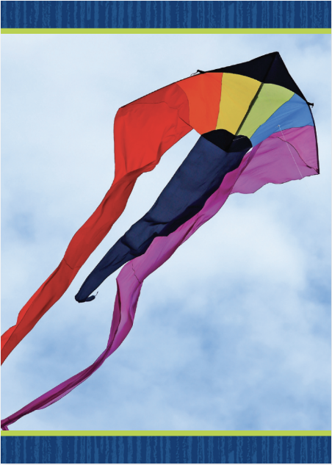
Phonics
kit
kite
Notes:
Write the word kit on the board. This is the word kit. Listen as I read the word: /k/ /i/ /t/, kit. I hear the sound /i/ in the middle of kit. Say the sound /i/ with me. Which letter makes the sound /i/? Have students identify the letter i.
Display the kite Picture Card. Click path -> Table of Contents -> Unit 3 Week 5 Informational Text -> Lesson 2 Write kite on the board. This is the word kite. In the word kite, I hear the sounds /k/ /ī/ /t/. The middle sound in kite is /ī/. Say the sound /ī/ with me.

Slide 19
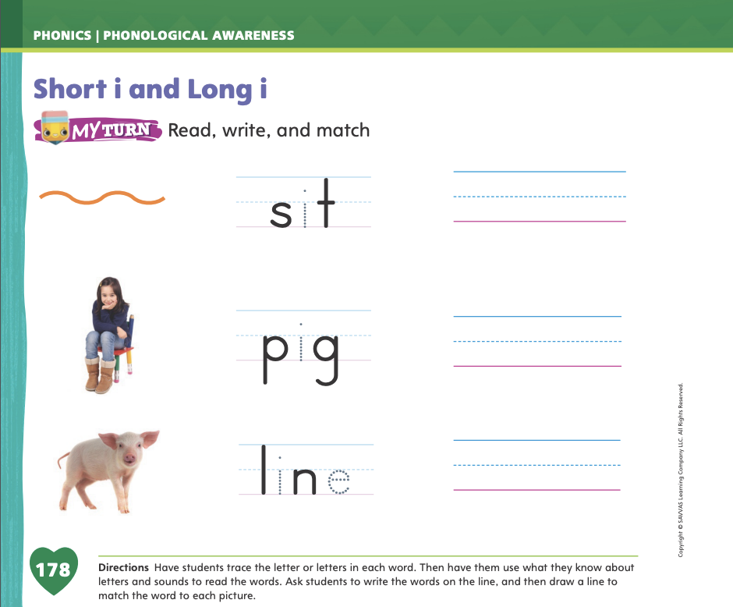
Page 178
Apply
Turn to page 178 in your Student Interactive and complete the activity.
Notes:
Have students turn to p. 178 in the Student Interactive. Have students trace the letter i in the word sit. Let’s read this word together: /s/ /i/ /t/, sit. The word is sit. Now let’s write the word sit on the line. Have students write the word sit on the line and then match it to the picture of a person sitting.
Have students complete the rest of p. 178 in the Student Interactive.

Slide 20
High-Frequency Words
funny
were
some
Notes:
Tell students that high-frequency words are words that they will hear and see over and over in texts. Write and read the words funny, were, and some. Have students
read each word.
spell each word, clapping as they say each letter.

Slide 21
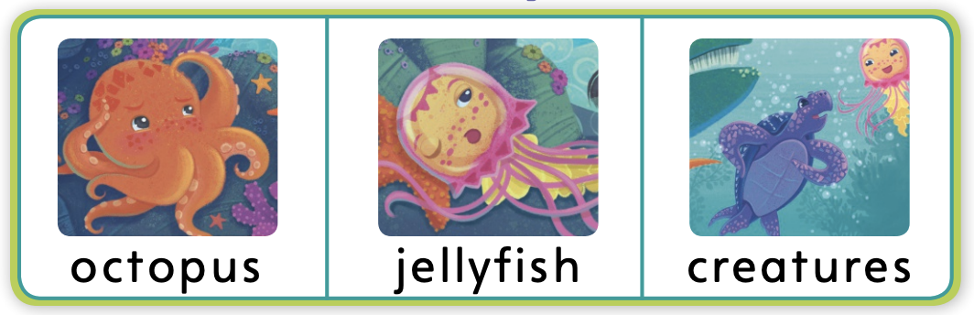
Page 190
Preview Vocabulary
Notes:
Introduce the selection vocabulary words from the Student Interactive p. 190: octopus, jellyfish, creatures.
As you read each word, have students look at the pictures and say what each word means.
Have students say what they already know about the words. Suggest that they use the pictures as support. Ask students whether they have ever seen any of these animals at an aquarium or on television.
Say: These words can help us understand the myth Mosni Can Help. As we read, look for these words.

Slide 22
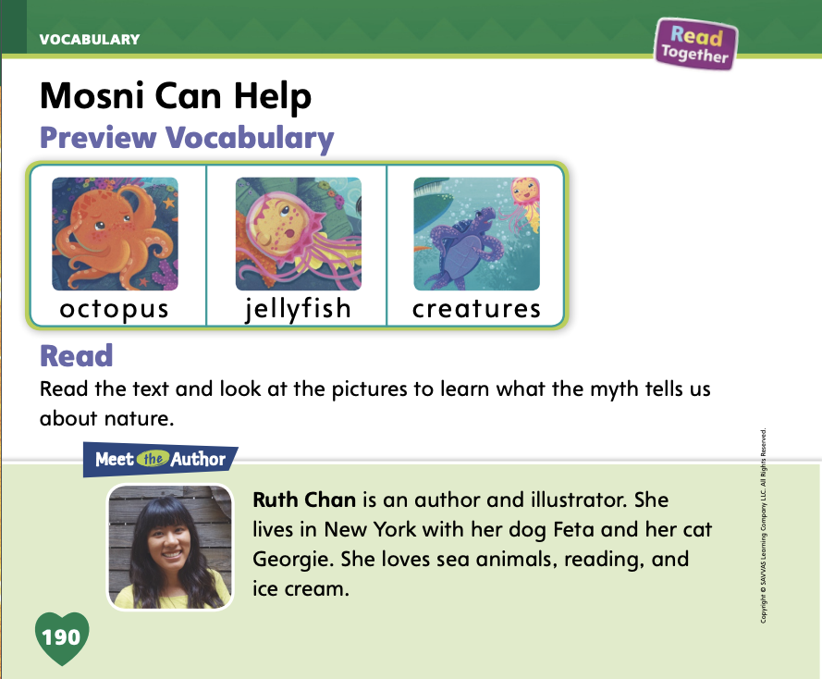
Page 190
Print Awareness
Turn to page 190 in your Student Interactive.
Notes:
Guide students to recognize that sentences are comprised of words separated by spaces and recognize word boundaries. Say: All texts are made up of sentences. Sentences are made up of words separated by spaces. Explain that students can find sentences by looking for a capital letter at the beginning and a punctuation mark at the end.
Have students identify the spaces between words, the capital letter at the beginning, and the punctuation mark at the end of each sentence on p. 190 of the Student Interactive.

Slide 23
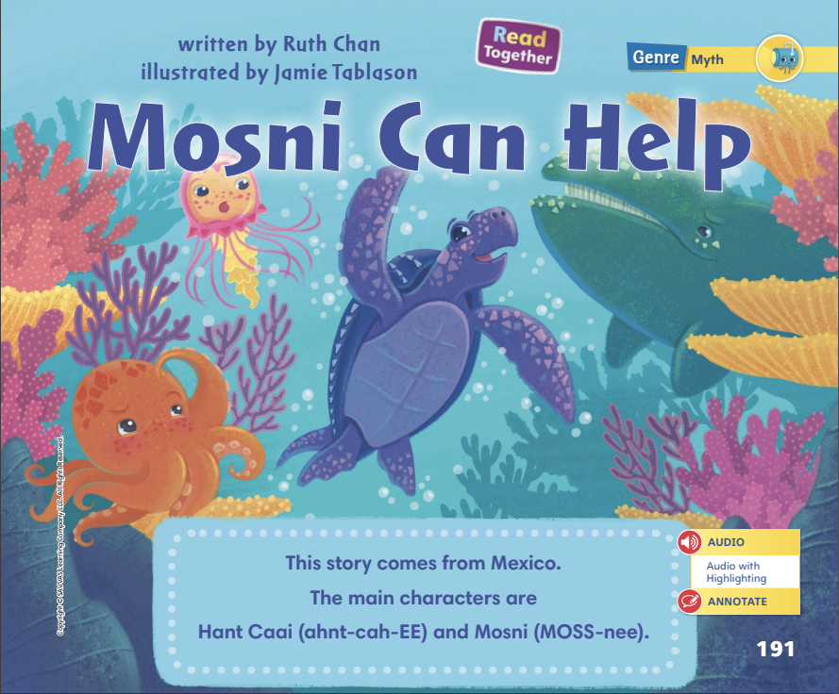
Page 191
First Read Strategies
Notes:
Discuss the First Read Strategies. In this first read, prompt students to read for understanding and enjoyment. After students complete the First Read, ask: What part of the story did you like most? Were there any parts that surprised you?
READ Read or listen to the text. Work to understand the main plot events.
LOOK Look at the pictures to help understand the text.
ASK Generate, or ask, questions about the text to deepen understanding of the myth and its plot.
TALK Talk to a partner about the text and retell it.
Help students read the whole text independently, in pairs, or as a whole class. Use the First Read notes to help students connect with the text and to monitor comprehension.

Slide 24
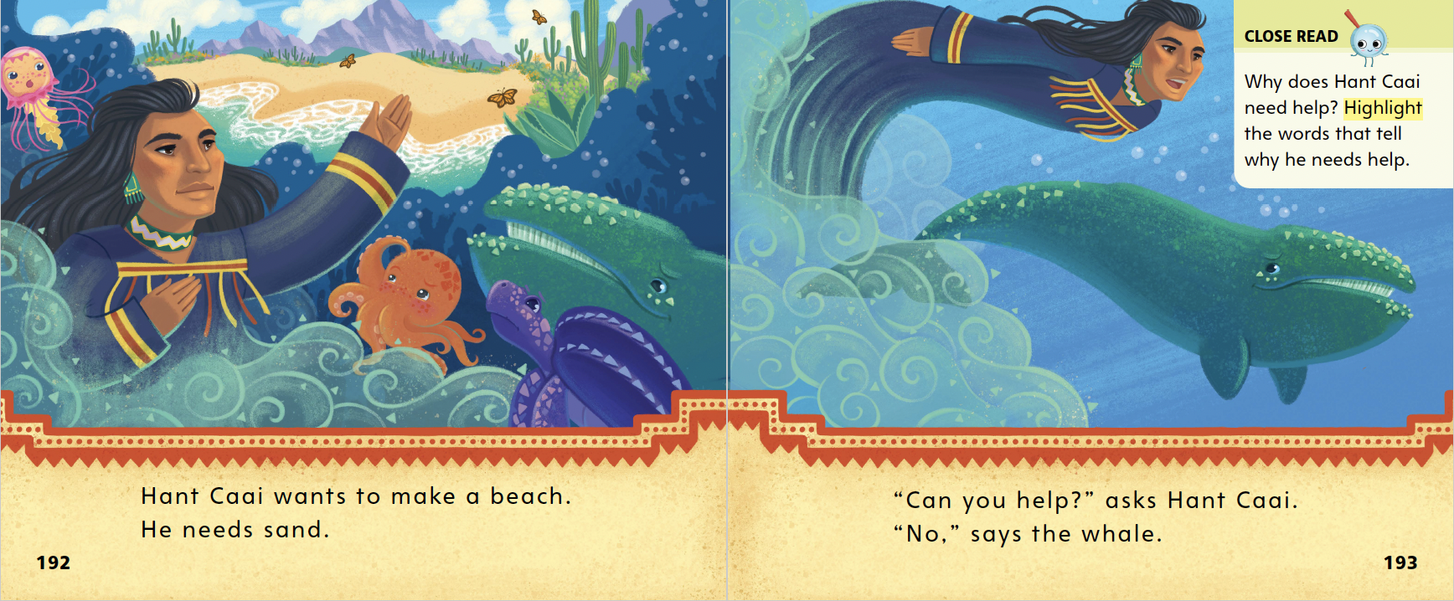
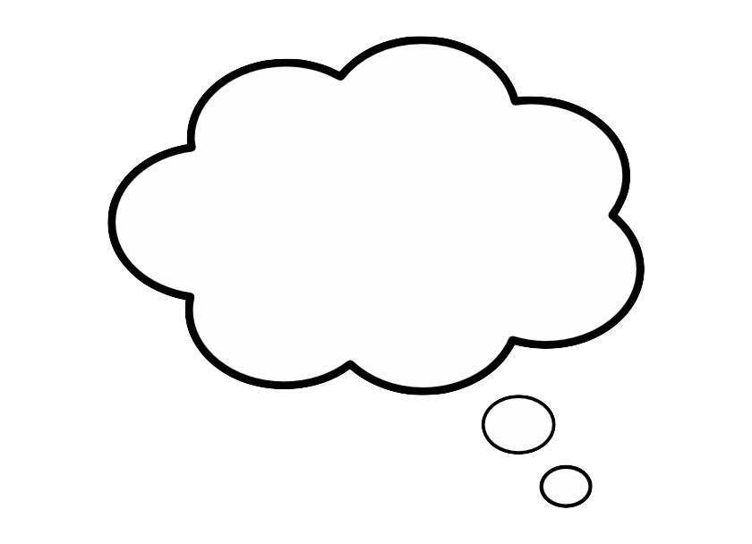
Page 192,193
First Read – Mosni Can Help
Notes:
Look together at the text.
THINK ALOUD Before I start to read, I ask myself questions. What will happen in this story? Hant Caai has a problem. He needs help to make a beach. Who will help him? I’m going to read to answer my question.

Slide 25
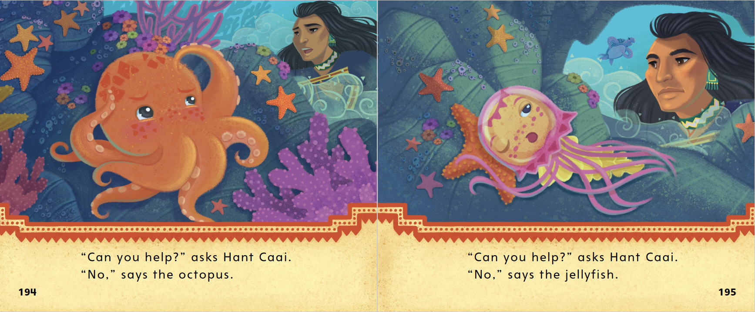
Page 194,195
First Read – Mosni Can Help
Notes:
Read together.

Slide 26
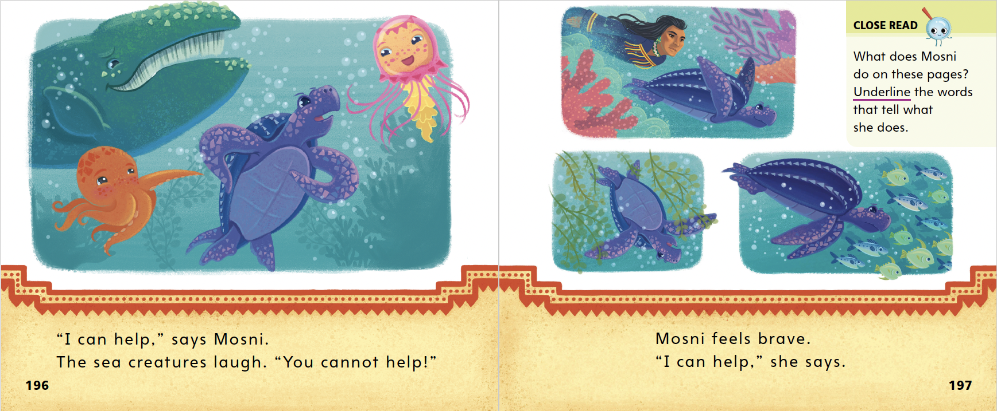
Page 196,197
First Read – Mosni Can Help
Notes:
Read together.
THINK ALOUD Mosni tells Hant Caai that she can help him. I think this is an important part of the story’s plot. Hant Caai was trying to solve a problem. Now someone will help him. This is the resolution to his problem.

Slide 27
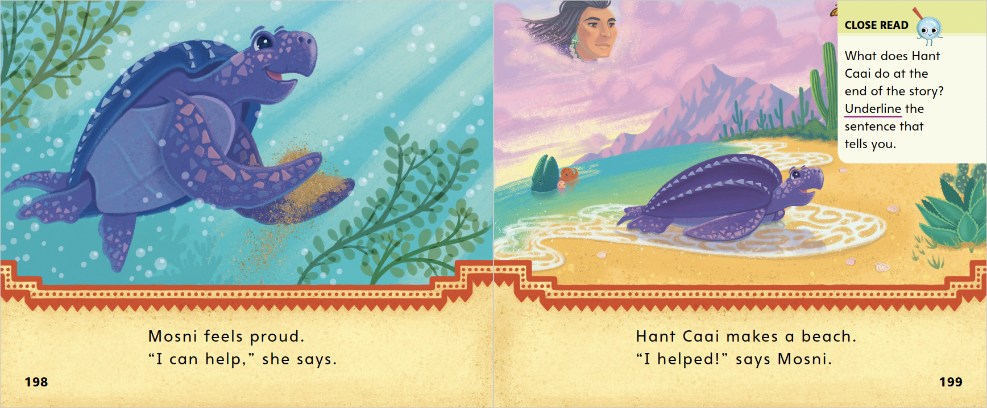
Page 198,199
First Read – Mosni Can Help
Notes:
Read together.

Slide 28
Respond and Analyze
Talk Ask students what they thought about the text.
Write or Draw Have students write or draw to respond to the text.
Notes:
Prompt students for their initial responses to the text.
Talk Ask students what they thought about the text. Ask them how the text made them feel. Ask them what their favorite moment in the text was.
Write or Draw Have students write or draw to respond to the text. Ask them to show or describe what the text made them think about and how the characters or plot reminded them of something in their own lives.

Slide 29
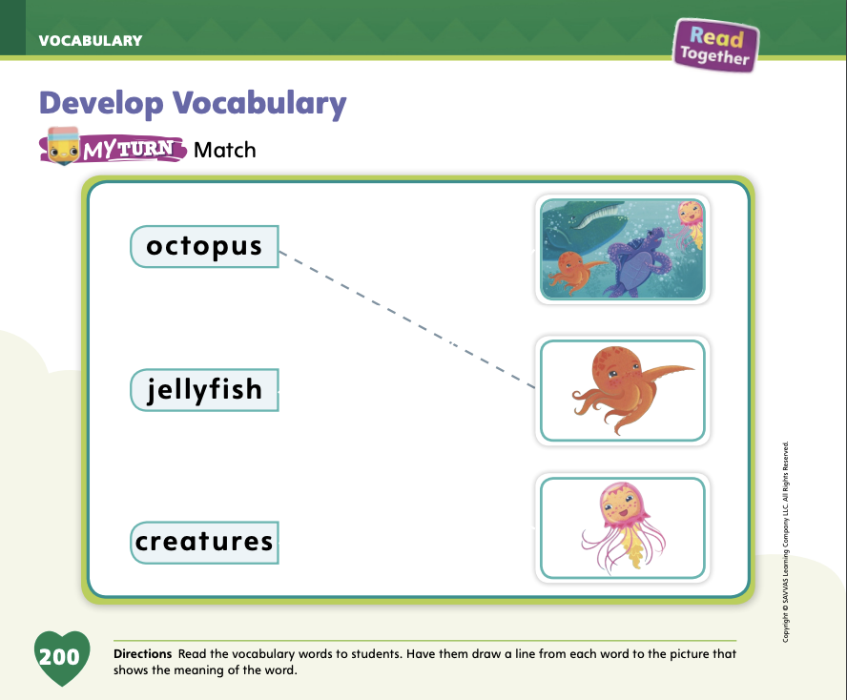
Page 200
Develop Vocabulary
Turn to page 200 in your Student Interactive and complete the activity.
Notes:
Explain to students that they can use illustrations to clarify the meanings of unknown words.
Look: Pay attention to the illustrations for clues to what an unknown word might mean.
Read: Read the whole sentence that contains the unknown word.
Think: Think about what part of the sentence the picture shows. Does that help you understand the meaning of the word?
Have students turn to p. 200 in the Student Interactive. Model the activity using the word octopus. Say: These pictures are from the story. Which picture shows an octopus? Indicate to students that the second image from the top shows an octopus. Explain that an octopus is a sea animal with eight arms.
Have students use the strategies for developing vocabulary.
Have students practice clarifying word meanings using illustrations by completing the rest of the activity on p. 200 in the Student Interactive.

Slide 30
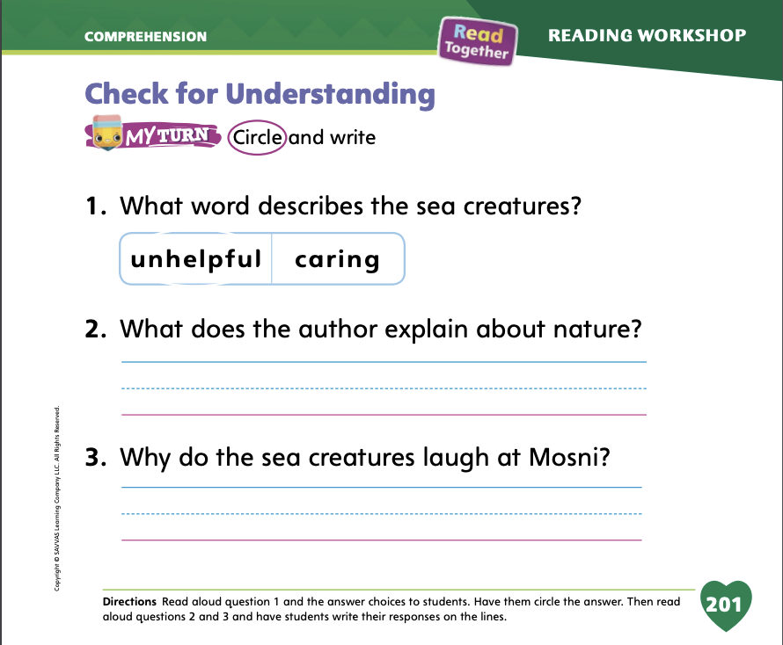
Page 201
Check for Understanding
Turn to page 201 in your Student Interactive and complete the activity.
Notes:
Have students complete the Check for Understanding on p. 201 in the Student Interactive.

Slide 31
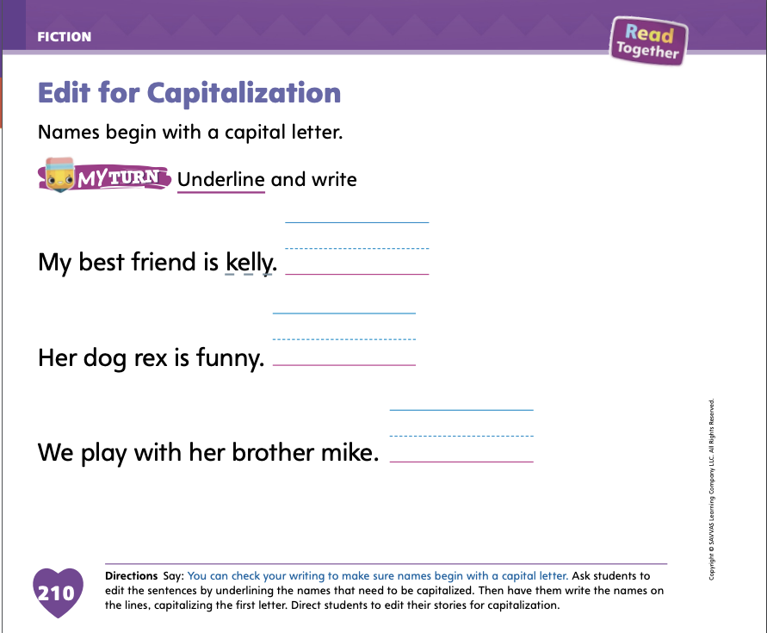
Page 210
Writing – Fiction
Turn to page 210 in your Student Interactive.
Notes:
Authors capitalize important words in their sentences. Names are always capitalized.
Say: Good writers go back and revise their work to make sure they have capitalized all the correct words in their story. If we didn’t capitalize a letter that should be capitalized, we can edit, or fix, it. Let’s talk about what words we should capitalize in our writing. One type of word that should be capitalized is a name. When we name a specific person or animal, the word should be capitalized.
Go through a stack text and point out the names in the story. Think aloud that it must be a name of a person or animal since the letter is capitalized. Write a sentence from a stack book on the board, but do not capitalize the character names. Work with students to edit the sentence for proper capitalization, crossing out the lowercase letters and writing the appropriate capital letters above them.
Have students complete the activity on p. 210 of the Student Interactive.

Slide 32
Independent Writing
Check your book for correct capitalization.
Reread your book and make sure all of the sentences and pictures are complete.
Notes:
Have students spend independent writing time editing their books. First, they should check their work for correct capitalization.
Then they should reread their book and make sure all of the sentences and pictures are complete.
Modeled Go back to the student’s writing and model editing words for capitalization.
Shared Have students identify capitals used in their writing.
Guided Use a stack text to provide explicit instruction about capitalizing words.
As students write, use the conference prompts in the Teacher’s Edition or Resource Download Center to provide support. Click path: Table of Contents -> Resource Download Center -> Writing Workshop Conference Notes
Call on a few students to show their revisions to the class. Prompt students to explain why it is important to go back and check for capitalization of names in a story.

Slide 33
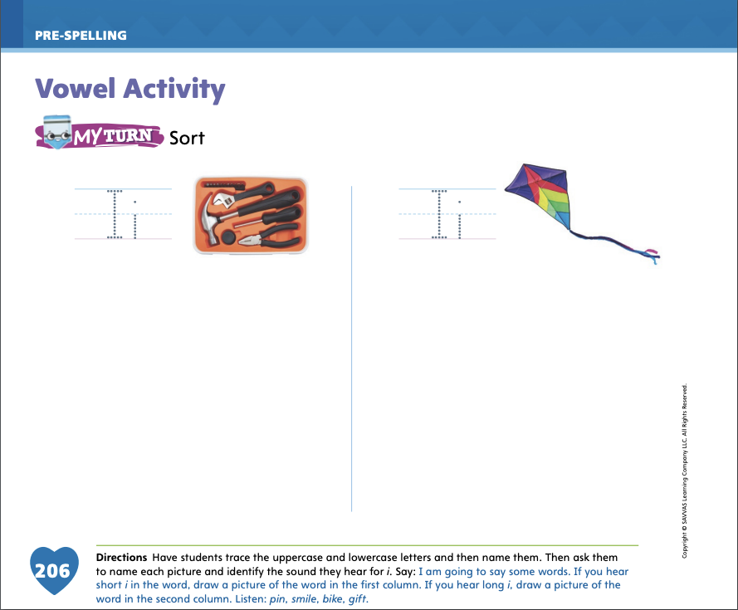
Page 206
Vowel Activity
Turn to page 206 in your Student Interactive.
Notes:
Remind students that words can have long vowel sounds and short vowel sounds. The word bit has a short i vowel sound. The word bite has a long i sound. Say some words and ask students if they hear a long or short vowel sound: hit, high, fine, fin, tip, type.
Have students turn to p. 206 in the Student Interactive. Have students point to the first picture. This is a toolkit. I hear a short i in the word kit. Ask students to point to the second picture and say its name. This is a kite. I hear long i in the word kite. Have students repeat the words. Then have them say the vowel sound as they trace the uppercase and lowercase Ii.
Explain that you are going to say some words. If the word has the short i sound as in kit, they should draw the picture in the first column. If it has the long i sound, they should draw it in the column under the kite. Then say the four words aloud, allowing enough time between each one for students to draw the pictures: pin, smile, bike, gift.

Slide 34
Language and Conventions
  I have an appointment in two days.
  She will do her homework before dinner.
  We have a test on Thursday.
  Let’s play a game after dinner.
Create sentences using the prepositions before and after.
Notes:
Say to students: You can use prepositions to tell when things happened or how events are related. I can say, "I will go to a movie next Saturday." The preposition next tells when I will go to a movie.
The prepositions before, after, on, and in are other prepositions I can use to tell when something will happen or has happened. I can say, “I will go to a movie on Friday.” The preposition on helps tell when I will go to the movie. Say the following sentences. Ask students to identify the preposition that tells when. I have an appointment in two days. She will do her homework before dinner. We have a test on Thursday. Let's play a game after dinner.
Have students take turns constructing sentences using the prepositions before and after. Provide sentence frames if necessary.

Slide 35
Lesson 3

Slide 36
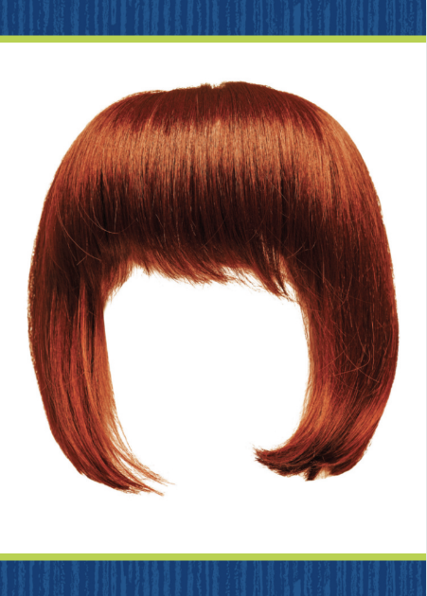

Phonological Awareness
Notes:
Tell students that today they will continue listening for and saying the sounds /i/ and /ī/. Display the wig Picture Card. Click path -> Table of Contents -> Unit 3 Week 5 Myth -> Lesson 3 This is a picture of a wig. Listen to the middle sound as I say this word: /w/ /i/ /g/. Does the word wig have the sound /i/ or /ī/ in the middle? Students should say the sound /i/. Display the kite Picture Card. Click path -> Table of Contents -> Unit 3 Week 5 Myth -> Lesson 3 This is a picture of a kite. Listen to the middle sound as I say this word: /k/ /ī/ /t/. Does the word kite have the sound /i/ or /ī/ in the middle? Students should say the sound /ī/.

Slide 37
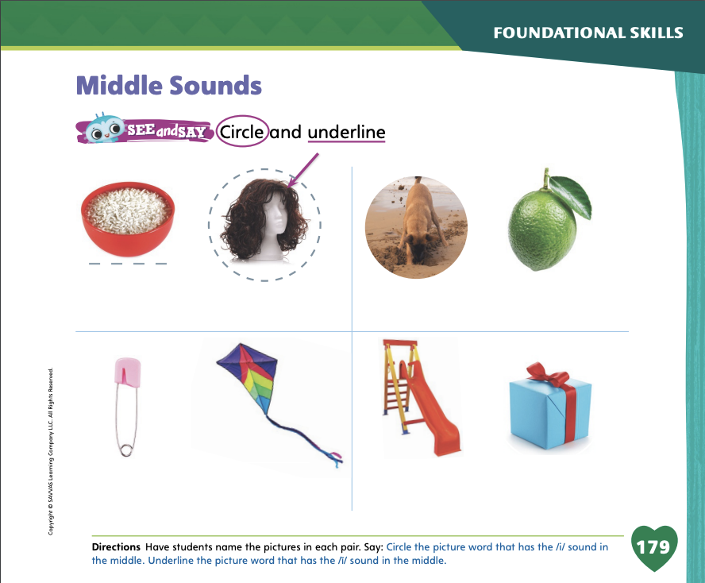
Page 179
Phonological Awareness
Turn to page 179 in your Student Interactive and complete the activity.
Notes:
Have students turn to p. 179 in the Student Interactive. Tell them they will circle the picture words with the middle sound /i/ and underline the picture words with the middle sound /ī/. Have students point to the first picture. Listen to the sounds in this word: /r/ /ī/ /s/. Rice has the sound /ī/ in the middle, so we will underline the picture. Name the pictures on p. 179 with students, and have them complete the page.

Slide 38
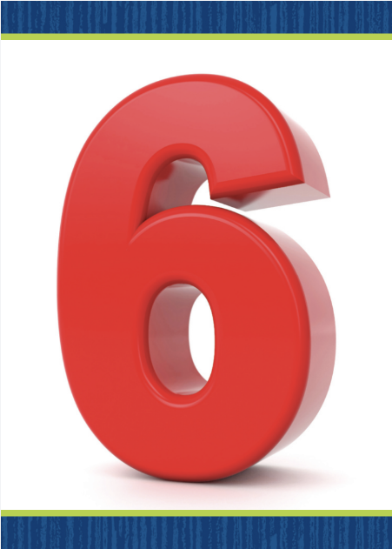
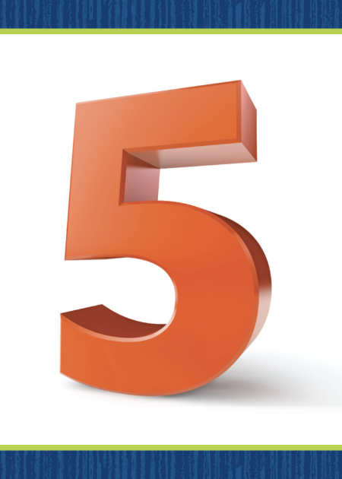
Phonics
six
five
Notes:
Hold up the six Picture Card. Click path -> Table of Contents -> Unit 3 Week 5 Myth -> Lesson 3 This is the number six. Listen to the sounds in the word: /s/ /i/ /ks/. What sound do you hear in the middle? (/i/) What letter spells the sound /i/? (the letter i) Turn the card over and show students the spelling of the word. Six is spelled s, i, x. Point to each letter as you read the word. Repeat the routine for /ī/ spelled i_e using the five Picture Card. Click path -> Table of Contents -> Unit 3 Week 5 Myth -> Lesson 3

Slide 39
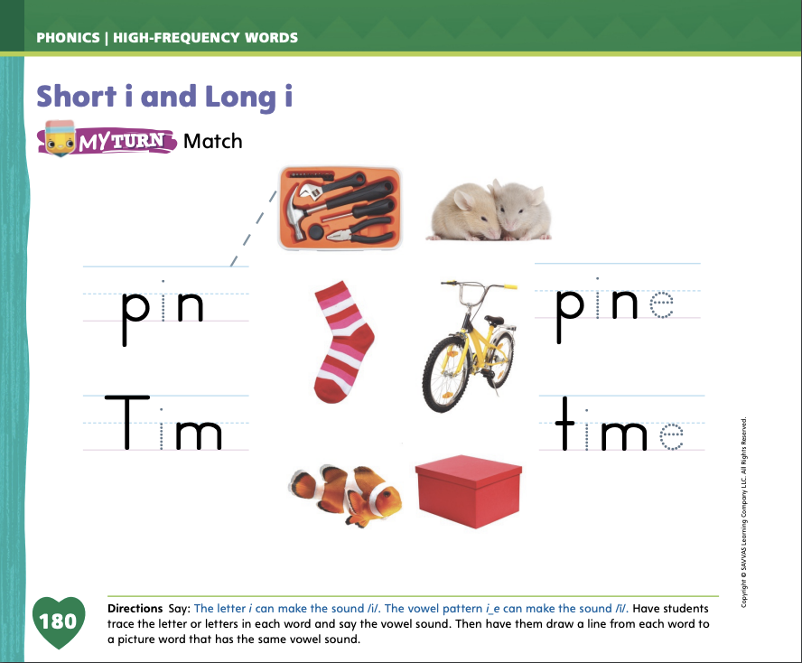
Page 180
Phonics
Turn to page 180 in your Student Interactive and complete the activity.
Notes:
Have students turn to p. 180 in the Student Interactive. Let’s trace the letter i in the first word and read it: /p/ /i/ /n/, pin. The word has the sound /i/. We will draw a line from the word pin to a picture with the same middle sound. Guide students as they draw a line to either the fish or the toolkit.
Have students complete the activity on p. 180, providing guidance when necessary.

Slide 40
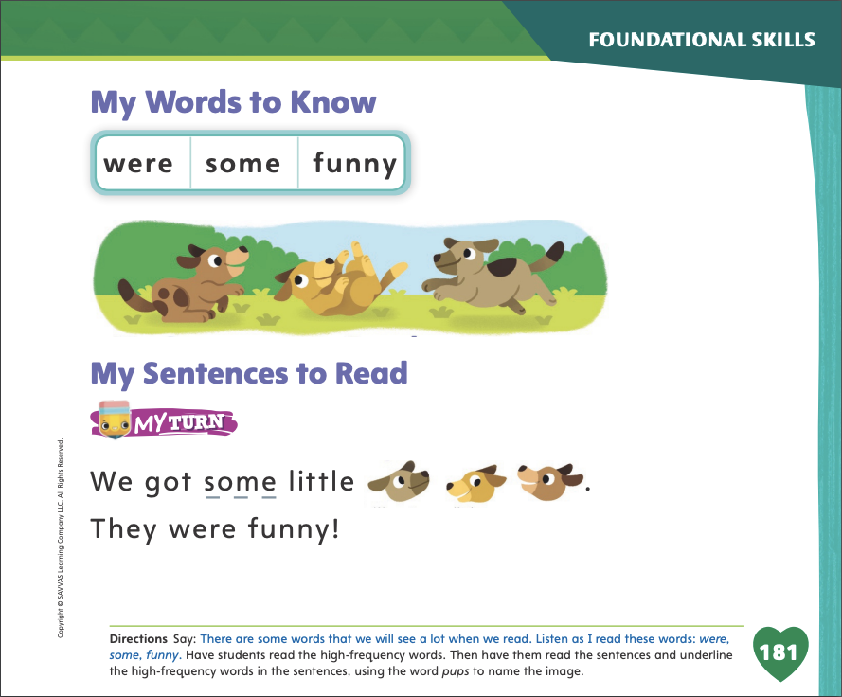
Page 181
High-Frequency Words
Turn to page 181 in your Student Interactive and complete the activity.
Notes:
Say: Today we will practice reading the high-frequency words, were, some and funny. Have students read the words at the top of p. 181 in the Student Interactive with you: were, some, funny.
Have students look at the words at the top of p. 181. Say: I will read a word, and I want you to point to it. Then we will read the word together. Read were, and have students point to it. Now let’s read the word together: were. Repeat with the other words. Have students use the words in sentences.
Have students read the sentences on p. 181 with you. Ask them to identify the words were, some, and funny in the sentences. Have them underline the high-frequency words in the sentences and then read the sentences with a partner.

Slide 41
Page 191
Describe Plot
Notes:
Explain that, by describing and thinking about a story’s plot, students will remember the story better. A plot has different parts: main events, a problem, and a resolution. Main events are the most important events that happen in the story. A problem is a challenge main characters in a story have to overcome. Resolution is the part in the story where the characters solve the problem.
Read the text and look at the photos. What are the characters doing?
Look at the pictures and words. Do the characters face any challenges, or problems? How do you know?
Look at the other pictures and read on. How do the characters solve their problems?
Remind students that they read Mosni Can Help. Have them turn to pp. 196 and 197 in the Student Interactive. Say: The main character, Mosni, does something on these pages. What a character does in a story makes up the story’s plot. The things that a main character does in a story contribute to the main events in the story. The main events in the story are the most important, or central, parts of the plot. Have students complete the Close Read note on p. 197. Provide assistance as needed.

Slide 42
Page 197
Close Read – Describe Plot
Turn to page 197 in your Student Interactive.
Notes:
Read aloud the Close Read note on p. 197 and help students find the sentences that show what Mosni does.

Slide 43
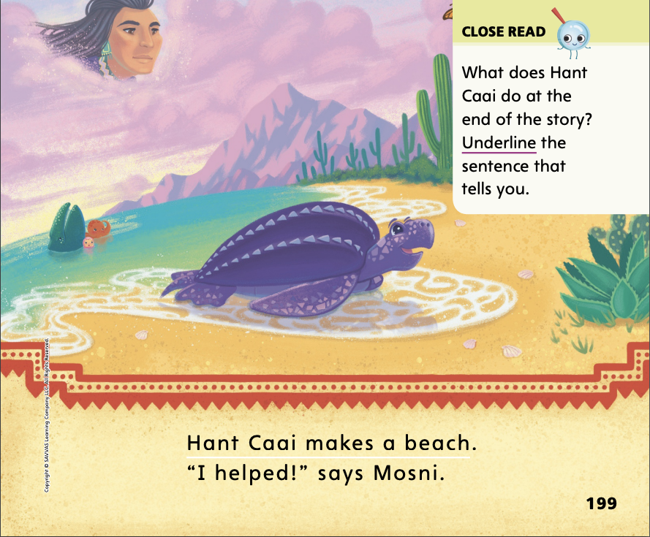
Page 199
Close Read – Describe Plot
Turn to page 199 in your Student Interactive.
Notes:
. Next, read aloud the note on p. 199 and have students underline the sentence that shows what happens at the end of the story. How did the story begin? What happened next? As a class, use responses to retell the plot.

Slide 44
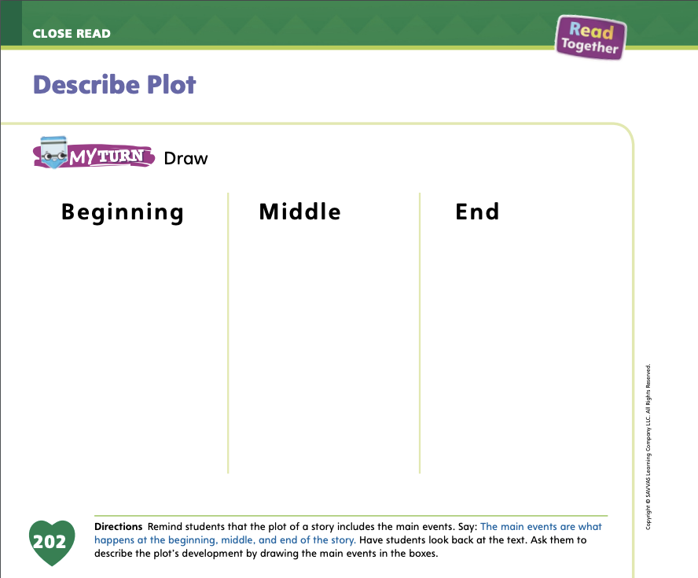
Page 202
Describe Plot
Turn to page 202 in your Student Interactive and complete the activity.
Notes:
Have students use the strategies for describing plot.
Have students complete the My Turn activity on p. 202 in the Student Interactive by drawing pictures for the different parts of the myth’s plot.

Slide 45
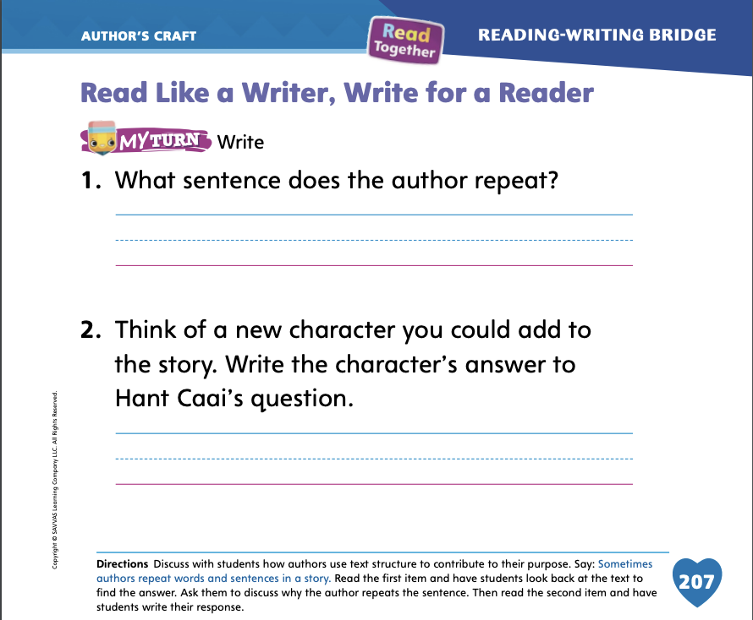
Page 207
Read Like a Writer, Write for a Reader
Turn to page 207 in your Student Interactive and complete the activity.
Notes:
Explain that authors often use the same words or sentences over and over to make texts interesting or to tell the reader what the author thinks is important in the story.
Authors may repeat a word, phrase, or sentence that is important to the story.
Noticing when something is repeated over and over again will help you understand the text.
To demonstrate how repetition is used to show the author’s purpose, direct students to p. 207 in the Student Interactive. Read aloud question 1. The question asks about something that repeats in the text. Authors repeat words or phrases to show us what ideas are important in a text. Help students answer question 1 by referring back to Mosni Can Help.
Have students write their answers to question 1 on p. 207 in the Student Interactive. Then have them complete question 2.

Slide 46
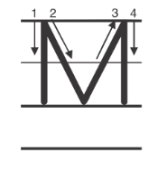
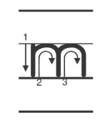
Handwriting
Notes:
Display upper- and lowercase Mm. Ask students to identify the uppercase M and the lowercase m.
Write the name Mat on the board. Point to the uppercase M. This is uppercase M. We use uppercase letters to begin sentences and names. Watch as I trace the uppercase M with my finger. Show students where to begin the letter and how to properly form it. Have students trace uppercase M on the surfaces of their desks.
Write the word mop on the board. This is the word mop. Point to the lowercase m. This is the lowercase m. Watch as I trace this lowercase m with my finger. Show students how to properly form the letter. Then have students trace the lowercase m on the surfaces of their desks.
Have students complete Handwriting p. 147 from the Resource Download Center to practice writing Mm. Click path: Table of Contents > Resource Download Center > Handwriting Practice > U2W2L3 Handwriting Practice

Slide 47
Writing – Fiction
  Character names begin with a capital letter.
  Setting includes details about place and time.
  Events are told in order.
  The plot has a problem and a resolution.
  Sentences have a naming part and an action part.
  Sentences use pronouns correctly.
  Sentences use adjectives and articles.
  Sentences begin with capital letters and end with periods.
Notes:
Before they celebrate their writing, authors make sure to revise and finalize their work. They make sure all of the sentences and pictures are complete, and they prepare their book in its final form.
Make a Writing Checklist for students to refer to as they revise their writing, incorporating what they have learned in this unit. As you write each item, recall for students the importance of checking for this in their writing.
Character names begin with a capital letter.
Setting includes details about place and time.
Events are told in order.
The plot has a problem and a resolution.
Sentences have a naming part and an action part.
Sentences use pronouns correctly.
Sentences use adjectives and articles.
Sentences begin with capital letters and end with periods.
Reread each item on your classroom Writing Checklist. Ask students if they have any questions about what to check in their writing. Display your Checklist so students can refer to it as they transition to independent writing.

Slide 48
Independent Writing
Revise the story you will present on Celebration day.
Notes:
Have students go back and revise their stories using the classroom Writing Checklist. Students should focus on revising the story they will be presenting on Celebration day.
Modeled As you look through student work, model using the checklist to revise.
Shared Have students identify how their work can be revised as they refer to the checklist.
Guided Prompt students to read the sentences in their stories and direct them to the checklist to revise.
If time allows, have students practice whisper reading their books.
As students write, use the conference prompts in the Teacher’s Edition or Resource Download Center to provide support. Click path: Table of Contents -> Resource Download Center -> Writing Workshop Conference Notes
Call on a few students to share something they revised. Tell students to discuss why it is important for writers to use a checklist before publishing their stories.

Slide 49
Language and Conventions
I went to to a movie.
My sister drove from Seattle.
Notes:
Write the following sentences on the board:
I went to to a movie.
My sister drove from Seattle.
Read aloud the two sentences. Underline the preposition in each sentence. Point out that the words that come after the preposition provide more detail.
I know that to is a preposition. In the sentence "I went to a movie," the word to is a preposition that tells where. I know that prepositions can tell where, and they can also tell when. Have students practice saying sentences using the prepositions to and from. Tell them to talk about places they have been to or places they will go to.

Slide 50
Lesson 4

Slide 51
Phonics
pin pine
Vin vine
Notes:
Hold up a safety pin and say: This is a pin. I hear the sound /i/ in the word pin. Write pin on the board. Point to the p and say /p/. Point to the i and say /i/. Point to the n and say /n/. Do you hear the sound /i/ in pin? Underline the i. What happens to a word that has the sound /i/ when we add an e to the end? Yes, the sound /i/ becomes the sound /ī/. Write pine on the board. Let’s read this word together: /p/ /ī/ /n/, pine.
Write the words Vin and vine on the board. Both words have the letter i. One word has the sound /i/ and one has the sound /ī/. Listen: /v/ /i/ /n/, /v/ /ī/ /n/. Which word has the sound /i/? Yes, Vin. What letters spell the word? (v, i, n) Repeat the routine with the word vine.

Slide 52
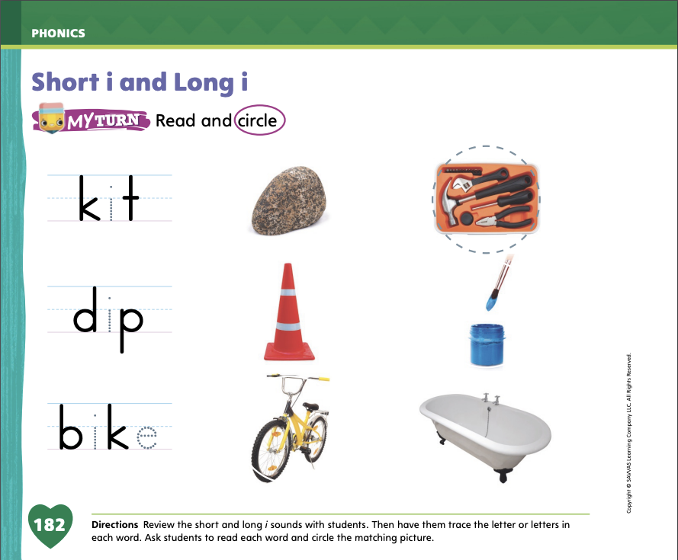
Page 182
Apply
Turn to page 182 in your Student Interactive and complete the activity.
Notes:
Have students complete p. 182 in the Student Interactive. Guide them as they decode the words.

Slide 53
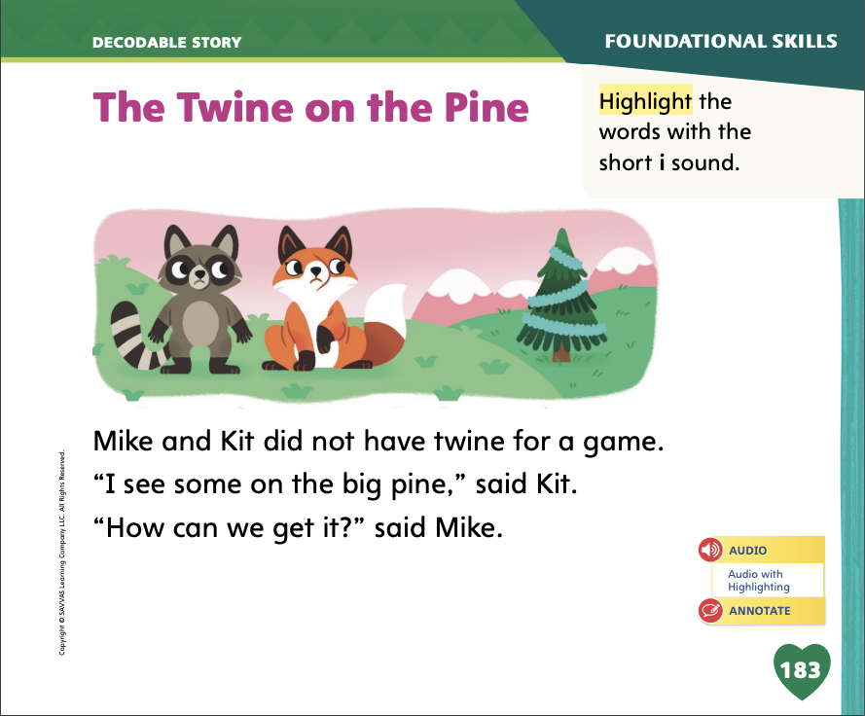
Page 183
Decodable Story
funny
were
some
Turn to page 183 in your Student Interactive. Read “The Twine on the Pine”.
Notes:
Have students turn to p. 183 in the Student Interactive. Today we are going to read a story about some animals that act like people. Point to the title of the story. The title is The Twine on the Pine. I see two words that have the long i pattern i_e. What are they? We can decode them. The first word is /tw/ /ī/ /n/: twine, and the second word is /p/ /ī/ /n/: pine. Have students find and point to the words. In this story, we will read other words that have sounds you have learned.
Remind students of this week’s high-frequency words: funny, were, some. Tell them they will practice reading these words in the story The Twine on the Pine. Display the words. Have students read them with you. When you see these words in the story The Twine on the Pine, you will know how to identify and read them.

Slide 54
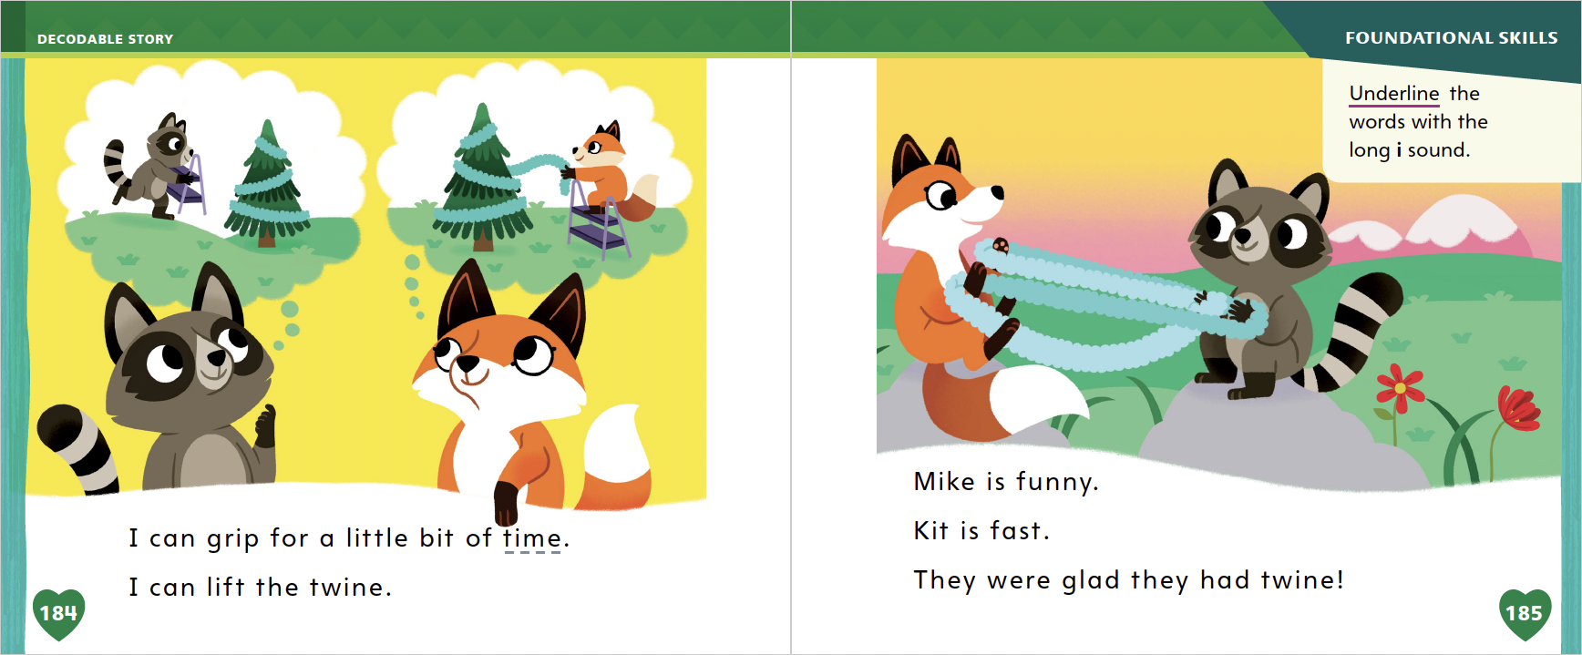
Page
184,185
Decodable Story
Notes:
Have students whisper read the story as you listen in. Then have students take turns rereading the story with a partner. Listen carefully as they use letter-sound relationships to decode.
After students read the story, review the words with the sound /i/ they read in the sentences on p. 183. Have them highlight the words with the sound /i/. Have students read the words to you.
Help students understand how they can determine meanings of words they do not know. We can ask questions about words we don’t know. I am not sure what the word twine means. I might ask questions to help me figure out what twine means. Sample questions: Is twine like a ball? Where is the twine on the pine tree? Can I use the characters’ faces to give me clues? Can I use the picture to give me clues? Now let’s answer some of the questions I asked. I know games that are played outside with a ball but I can’t think of any games that I know of that use something called twine, so I’m not sure if twine is like a ball. I can look at the pine tree. The light green stuff on the tree that zig-zags is the only thing I haven’t seen before on a pine tree. Maybe that’s twine. The characters’ faces don’t give me any clues, but the picture of the pine tree does. Twine looks like something that you decorate with. Tell students to ask and answer questions about words they don’t know that they read in texts.
Call students’ attention to the first sentence on p. 184. Which word has the sound /ī/ in the middle? Point to it. Help students identify the sound /ī/. Then have them underline the word time. What is another word that has the sound /ī/ in the second sentence? Point to it. Tell students to underline the word twine.
Have students look at the rest of the story on p. 185. Which words have the sound /ī/? Point to them. Help students identify the sound /ī/ in each word. Then have them underline the words with the sound /ī/.

Slide 55
Page 191
Make Connections
Notes:
Explain to students that connecting what they read to their own life experiences and to other texts they have read helps them better understand what they read.
Tell students they can connect different types of stories, such as myths, to each other because myths talk about nature. You can make connections between the texts by looking at what they teach us about the natural world.
Point out to students that they can use the characters in stories to make connections to their lives and to other texts. Many stories have a main character who has to solve a problem. How are the characters like you? How do they solve problems differently?
Tell students they can connect different stories based on the plot. Explain that connecting plot events among stories and then to real life events will help them understand the author’s message about life.
Have students look at pp. 192 and 193 in the Student Interactive. Ask them to say what happens on these pages. Then say:
Hant Caai has a problem he needs to solve.
I can connect this text to another text we have read, such as The Story of Cornbread Man, by describing a part of the plot. Hant Caai needs help making a beach. In The Story of Cornbread Man, Grandma also has a problem: The cornbread man that she baked ran away.

Slide 56
Page 192,193
Close Read – Make Connections
Turn to page 192 and 193 in your Student Interactive.
Notes:
Read aloud the Close Read note on p. 193. Have students find the words that tell why Hant Caai needs help. Then have students connect Mosni Can Help to another text they have read. Ask students to identify the problem that Hant Caai has. Then ask them to identify another character’s problem they read recently, such as Bear’s tail getting caught in the ice. DOK 3

Slide 57
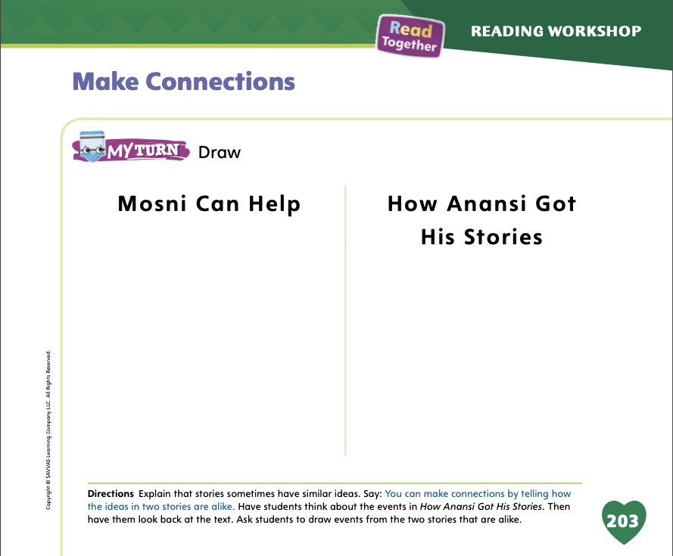
Page 203
Make Connections
Turn to page 203 in your Student Interactive and complete the activity.
Notes:
Have students use the strategies for making connections.
Have students complete the drawing activity on p. 203 in the Student Interactive. Review the story about Anansi as needed. Then have students share their drawings with the class.

Slide 58
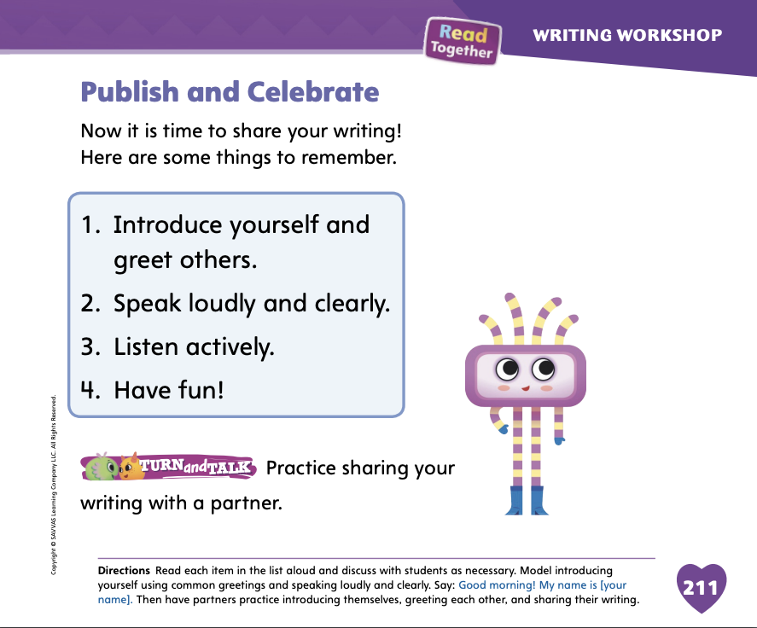
Page 211
Writing – Fiction
Turn to page 211 in your Student Interactive and complete the activity.
Notes:
Celebrating student writing is an essential part in growing your students’ confidence and writing ability. While students perform at different levels, you can celebrate each student’s progress and provide positive reinforcement and recognition among peers.
Tell students that you will celebrate your writing by reading it aloud to the class. Do a Think Aloud before sharing, recalling what to do when speaking to classmates. For example, I recall I should introduce myself to the group. I should speak loudly and clearly so everyone can understand. I also recall that my audience should listen actively so they can make suggestions when I’m done reading.
Model for students how to introduce yourself using a common greeting. Then read your story or a book from the stack aloud, speaking slowly and clearly. When you are finished reading, encourage students to ask questions and provide suggestions. Model using active listening and acknowledging student suggestions. Accept or reject suggestions, providing reasons for doing so.
Have students turn to p. 211 in the Student Interactive. Review the list as a class, and then have students practice sharing their writing with a partner before the formal Celebration begins.

Slide 59
Independent Writing
Share your writing with the class.
Notes:
Have students share their writing with the class. Prompt students to ask questions and provide positive feedback or suggestions.

Slide 60
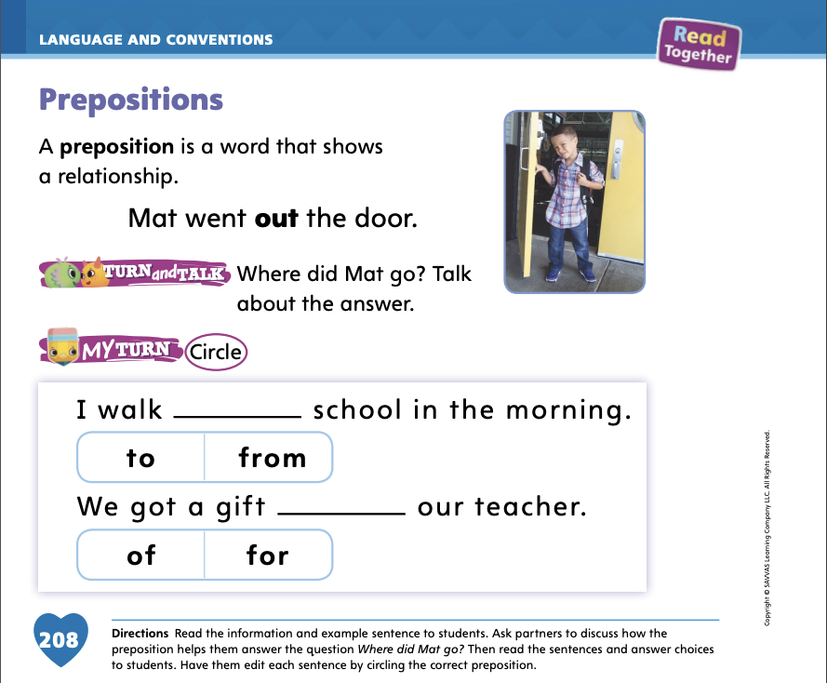
Page 208
Language and Conventions
Turn to page 208 in your Student Interactive and complete the activity.
Notes:
Have students practice using prepositions and prepositional phrases. Have students work with a partner to list prepositions. Then have pairs share their examples as you list them on the board. Provide a sentence and ask students to choose a preposition to add a detail.

Slide 61
Lesson 5

Slide 62
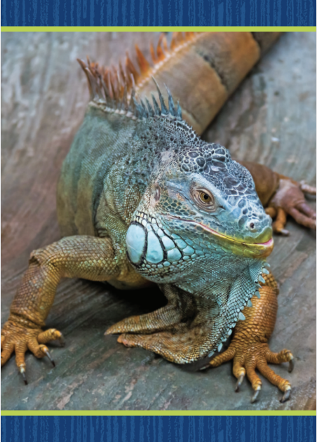
Phonological Awareness
Notes:
Remind students that syllables are word parts and that each syllable in a word has one vowel sound. Display the iguana Picture Card. Click path -> Table of Contents -> Unit 3 Week 5 Myth -> Lesson 5 This is a picture of an iguana. Listen carefully as I say the word and clap the syllables: i (clap) gua (clap) na (clap). How many times did I clap? Students should say three. I clapped three times, so there are three syllables in the word. Now listen as I say the word panda. Clap the syllables with me: pan (clap) da (clap). How many syllables are in panda? Students should say two.
Have a volunteer say his or her name as students clap the syllables. Have students hold up their fingers to show how many syllables are in that name. For example, for the name José, students should hold up two fingers. Continue until all students have said their names.

Slide 63
Phonics
yip
bit
i_e
win
ride
wide
i
time
will
bill
wide
Notes:
Write the letter i and the pattern i_e on the board. Have students identify the letters as you point to them. Then review the sound for each spelling: /i/ and /ī/.
Write the word win on the board. Have students read the word with you. We will blend this word together. If you hear the sound /i/, touch your toes. If you hear the sound /ī/, touch your head. Point to each letter as you blend the sounds and read the word. Repeat with these words: yip, ride, wide, bill, bit, wide, will, time.

Slide 64
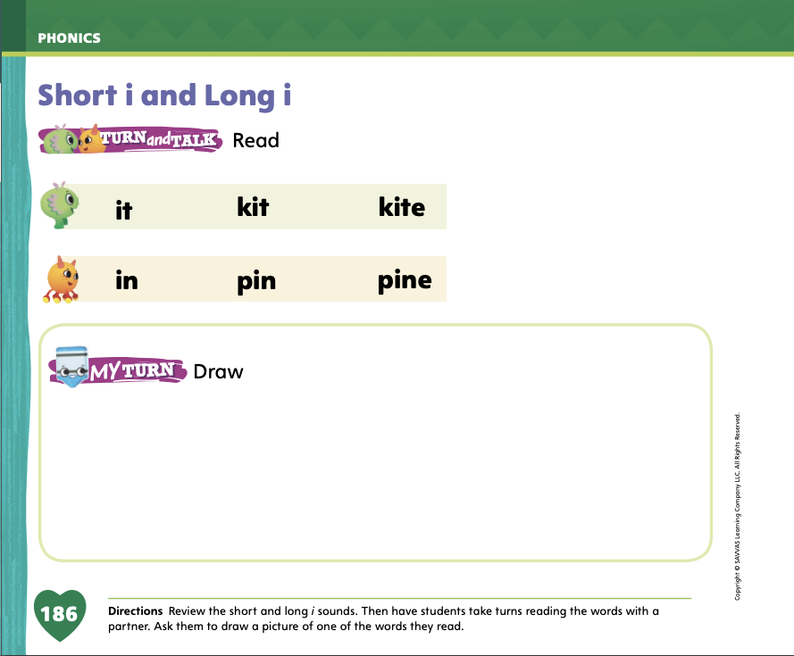
Page 186
Phonics
Turn to page 186 in your Student Interactive.
Notes:
Have students turn to p. 186 in the Student Interactive. Have them read the words in each row with a partner. Then have them draw one of the words in the box.

Slide 65
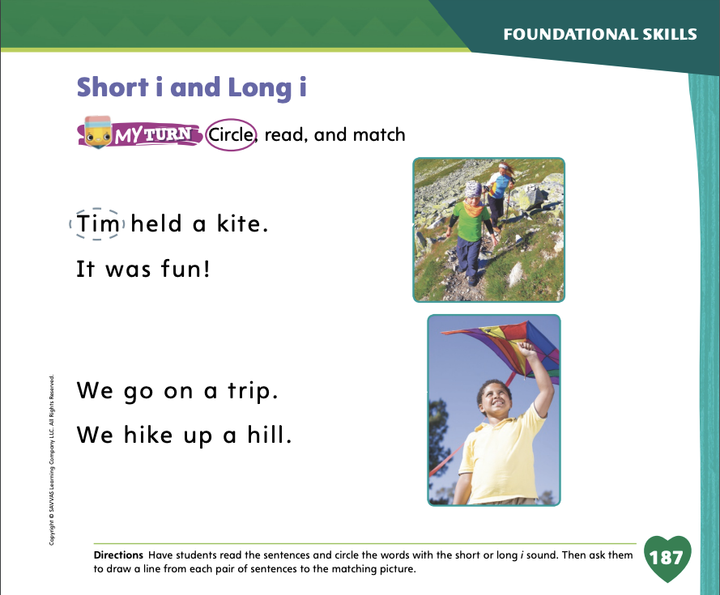
Page 187
Apply
Turn to page 187 in your Student Interactive and complete the activity.
Notes:
Have students look at pg. 187 in the Student Interactive. Have them read the sentences and circle the words with short i and long i. Then have students match each pair of sentences to one of the pictures.

Slide 66
High-Frequency Words
funny
were
some
Notes:
Remind students that high-frequency words are words that appear over and over in texts. Remind them they will be learning many of the words this year, which will help them become better readers. Say the word funny and ask students what letters spell the word. Have students
say the letters of the word as you write them on the board.
say and spell the word, doing a silent cheer for each letter.
repeat with were and some.

Slide 67
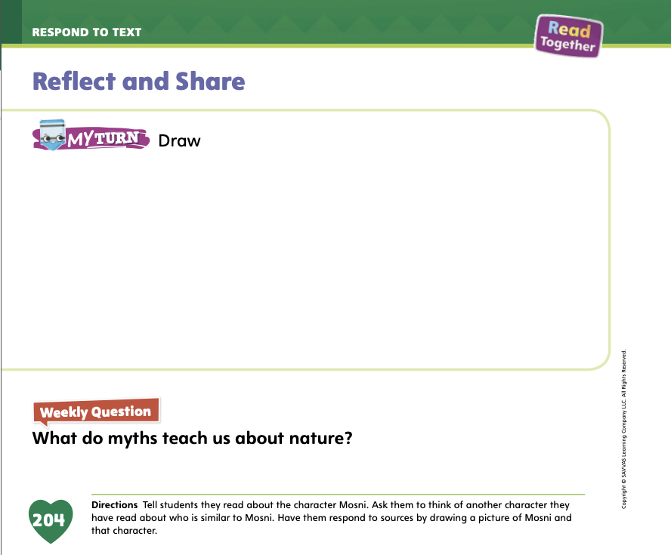
Page 204
Reflect and Share
Turn to page 204 in your Student Interactive.
Notes:
Guide students to understand that comparing texts they have read and writing about the connections they are able to make will help them better understand the texts. Say: Writing about texts makes you think more about them. It can help you better understand and appreciate what you have read.
Think about the main events and characters in the stories.
Think about how the events or characters are alike and different.
Draw to show how the stories are alike or different.
Model a written response to a text. Ask students to reflect on the weekly text Mosni Can Help. Say: This story made me think about the main character, Mosni. I wanted Mosni to do a good job of helping Hant Caai. I felt bad for Mosni when the other animals laughed. I also felt bad for Miss Hazelnut when the gingerbread man ran away. I will draw these two characters.
Ask students to think about how Mosni is like another character they have read about and then draw the two characters.
Have students use the strategies to connect ideas across texts.
Have students complete the drawing activity on p. 204 in the Student Interactive. Then have students share their drawings with the class.

Slide 68
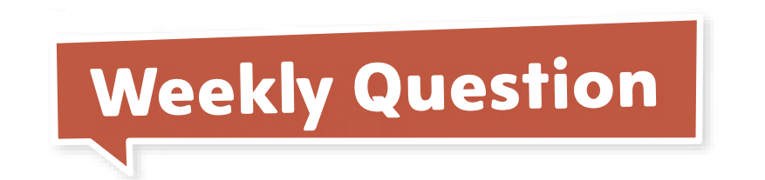
Page 204
Apply
What do myths teach us about nature?
Notes:
Have students use evidence, ideas, and details from the texts they have read this week in order to respond to the Weekly Question. Have them discuss the Weekly Question in small groups.

Slide 69
Writing – Assessment
Write a fiction book.
First, plan the characters, settings, and events for your book.
Then write or draw your story.
Notes:
Assessments in writing help you understand what your students comprehend from this unit and/or where they may need additional support. As you review their assessment, make note of what the student did well and what could be stronger. You may wish to share this feedback with your students to help improve their writing and provide positive reinforcement.
Tell students that today they will be responding to an assessment prompt. This assessment will be about fictional stories. Have students recall some stories from this unit, either stories they wrote or stories from the stack.
Tell students that before you respond to an assessment prompt, you like to review what you have learned. Think aloud as you recall the following from this unit. Write each sentence on the board or chart. Take student questions and ideas as you write.
Fictional stories are made up.
They have characters and settings.
Fictional stories have a problem and a solution.
The beginning introduces the characters, setting, and problem. The ending explains how the problem is solved.
Authors edit their stories for complete sentences.
Authors also edit their stories for the proper use of pronouns, adjectives and articles, capitalization, and end punctuation.
Remind students to remember these ideas as they begin their assessment.
See the unit assessment on p. T425 and inform students that they are going to take a writing assessment. Another form of assessment is to score students’ published writing using the rubric on p. T425. Click path -> Table of Contents -> Unit 3 Week 5 Writing Workshop

Slide 70
Language and Conventions
I went home after school.
Which word in the sentence is a preposition?
    A. I
    B. went
    C. home
    D. after
Notes:
Display the following sentence and guide students to complete the question.
I went home after school.
Which word in the sentence is a preposition?
I
went
home
after
Have students complete Language and Conventions p. 152, from the Resource Download Center. Click path: Table of Contents -> Resource Download Center -> Language and Conventions -> U2 W2

Slide 71
Unit 3: Week 5
Grade K

